Slide 1
CSI3344 Distributed Systems
Lecture 3:
Communications (1)
  3.1 Open Systems Interconnection Model
  3.2 Internet Communication Model
  3.3 Data Communication Standards
Major Points
Reading Guide
Distributed Systems
CSI3344
Notes:
Recall: A distributed system is a system in which hardware and software components located at networked computers communicate and coordinate their actions only by passing messages.
Two levels of communication (1) network level – e.g., for coordination of communication
(2) passing messages: data trasfer including inter-processes communication

Slide 2
CSI3344 Distributed Systems
Objectives
Be familiar with the OSI Protocols;
Describe the roles of each layer in OSI Protocols;
Be familiar with the Internet communication model;
Discuss correlations between OSI model and Internet communication model;
Be aware of data communication standards.
Distributed Systems
CSI3344

Slide 3
3.1 Open Systems Interconnection Model (1)
What are communication protocols?
  Protocols are the rules that communication processes must adhere to.
  Protocols are often constructed in the form of layers.
Inter-process communication is at the heart of all distributed systems.
Communication in distributed systems is always based on low-level message passing as offered by the underlying network.
Distributed Systems
CSI3344

Slide 4
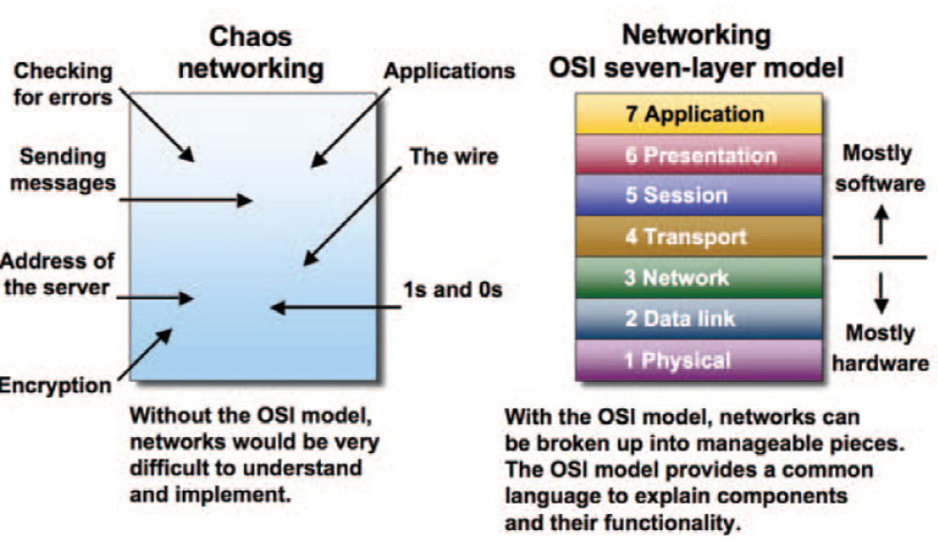
The OSI Model overview
3.1 Open Systems Interconnection Model (2)
Copyright © 2006 Global Knowledge Training LLC
CSI3344
Distributed Systems
Notes:
View demo example, say “ The OSI Model Animation” at
https://www.youtube.com/watch?v=-6Uoku-M6oY
Or by search “The OSI Model Animation”

Slide 5
3.1 Open Systems Interconnection Model (3)
(ISO) OSI Model or Protocols
Message sent
Message received
Layers
Application
Presentation
Session
Transport
Network
Data link
Physical
Sender
Communication
Recipient
medium
Distributed Systems
CSI3344

Slide 6
3.1 Open Systems Interconnection Model (4)
  ISO – International Standards Organization
  OSI – Open Systems Interconnection Reference Model
The layered (ISO) OSI Protocols set standard rules that govern the format, contents, and meanings of mssages sent and received.
Each of the seven layers deals with one specific aspect of the communication.
Distributed Systems
CSI3344

Slide 7
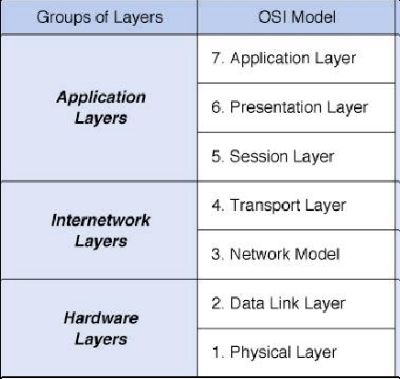
3.1 Open Systems Interconnection Model (5)
The seven layers of OSI Protocols can be grouped into three groups.
Distributed Systems
CSI3344

Slide 8
3.1 Open Systems Interconnection Model (6)
The Application layers map to the top 3 layers in on OSI model, and are the user’s connection to the network and include the application software and other software used to connect the application to the network:
  7. Application layer: provides a set of utilities used by application programs.
  6. Presentation layer: formats data for presentation to the user, provides data interfaces, data compression and translation between different data formats.
  5. Session layer: responsible for initiating, maintaining and terminating each logical session between sender and receiver.
Distributed Systems
CSI3344
Notes:
Data Exchange Process
In data exchange process, participating computers work in reverse mode. Layers on receiving computer perform the same task in reverse mode.
The receiving device takes delivery of, handles, and translates the data from the sending device at a particular layer. For example on sending computer presentation layer compress the data, same presentation layer on receiving computer decompress the data.
On sending computer
Sending application access the application layer.
Application provides data to the presentation layer.
Presentation layer format the data as per network requirement and forward it's to session layer.
Session layer initiate the connection and forward the data to the transport layer.
Transport layer broke down the large data file in smaller segments and add a header with control information, which are bits designated to describe how to determine whether the data is complete, uncorrupted, in the correct sequence, and so forth.
Segments are forwarded to the network layer. Network layer add its header, with logical address and convert it in packet. Network layer forwards packet to data link layer.
Data link layer attach its header and footer to the packet and convert it in frame.
Frames are forwarded to the physical layers that convert them in signals. These signals are loaded in media.
On receiving computer
Physical layer receive signals from media and convert them in frames. Frames are forwarded to the data link layer.
Data link layer check the frame. All tampered frame are dropped here. If frame is correct, data link layer strip down its header and footer from frame and hand over packet to network layer.
Network layer check the packet with its own implementations. If it's found everything fine with packet, it strips down its header from packet and hand over segment to transport layer.
Transport layer again do the same job. It verifies the segments with its own protocol rules. Only the verified segments are processed. Transport layer remove its header from verified segments and reassemble the segments in data. Data is handed over the session layer.
Session layer keep track of open connection and forwarded the receiving data to presentation layer.
Presentation form the data in such a way that application layer use it.
Application layer on receiving computer find the appropriate application from the computer and open data within particular application.

Slide 9
3.1 Open Systems Interconnection Model (7)
The Internetwork layers connect applications to the network and determine the best route for sending messages between sender and receiver.
  4. Transport layer: deals with end-to-end issues such as segmenting the message for network transport, and maintaining the logical connections between sender and receiver.
  3. Network layer: responsible for making routing decisions.
Distributed Systems
CSI3344

Slide 10
3.1 Open Systems Interconnection Model (8)
Example 1 (part 1):
Routing in a wide area network
Hosts or
local
networks
Destination
node
A
1
B
2
3
Links
4
C
5
D
6
E
Routers
Distributed Systems
CSI3344

Slide 11
3.1 Open Systems Interconnection Model (8)
Example 1 (part 2): Routing tables
Routing tables are held at each of the routers. The routing decision is made on a hop-by-hop basis, using locally held information to determine the next hop to be taken by each incoming packet.
Link: the outgoing link for packets addressed to the destination.
Cost: the number of hops to the given destination.
Routings from A
Routings from B
Routings from C
To
Link
Cost
To
Link
Cost
To
Link
Cost
A
local
0
A
1
1
A
2
2
B
1
1
B
local
0
B
2
1
C
1
2
C
2
1
C
local
0
D
3
1
D
1
2
D
5
2
E
1
2
E
4
1
E
5
1
Distributed Systems
CSI3344

Slide 12
3.1 Open Systems Interconnection Model (10)
The Hardware layers move messages from one computer or device to another.
  2. Data Link layer: deals with message delineation, error control and network medium access control.
  1. Physical layer: defines how individual bits are formatted and then transmitted through the network.
Distributed Systems
CSI3344
Notes:
Delineation the action of indicating the exact position of a border or boundary

Slide 13
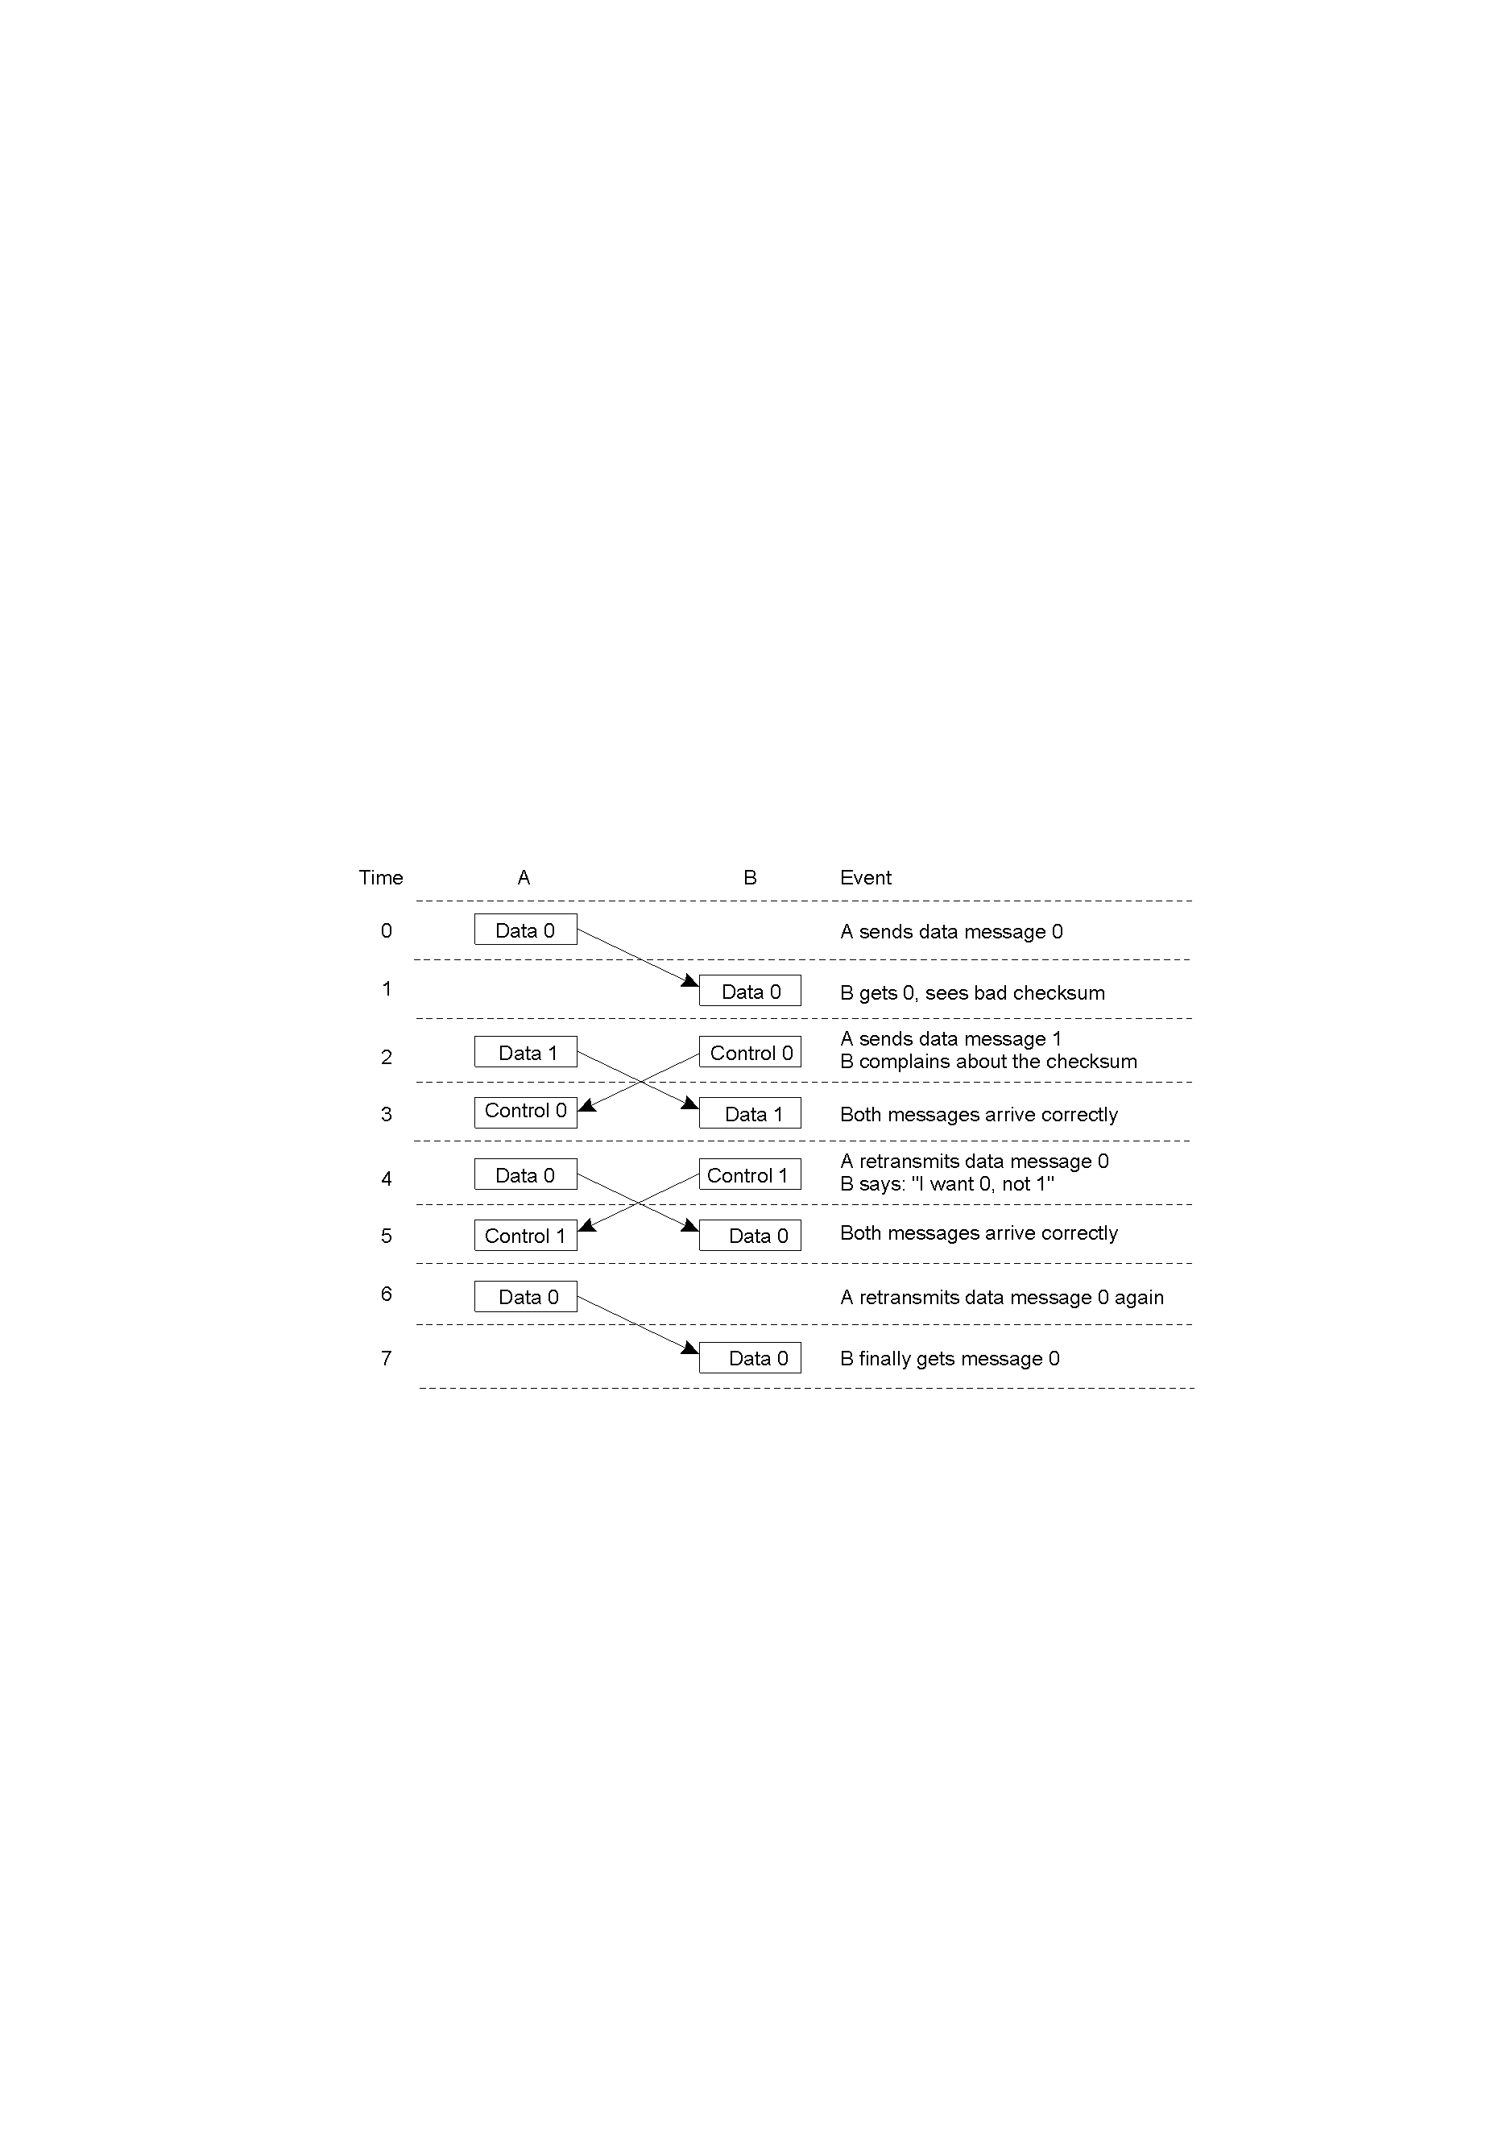
3.1 Open Systems Interconnection Model (11)
Example 2:
Discussion between a receiver and a sender in data link layer
Distributed Systems
CSI3344

Slide 14
3.1 Open Systems Interconnection Model (12)
Some Terms
  Bits sent from physical layer are grouped in data link layer into units (called frames), and then a special bit pattern is added to the start of each frame, and at last a checksum counting up all the bytes in the frame is added to the frame in certain way.
  The technical term for a message in Network Layer is called packet.
  How to choose the best path from the sender to the receiver on the network is called routing, which is only needed for a wide-area network (WAN).
Distributed Systems
CSI3344

Slide 15
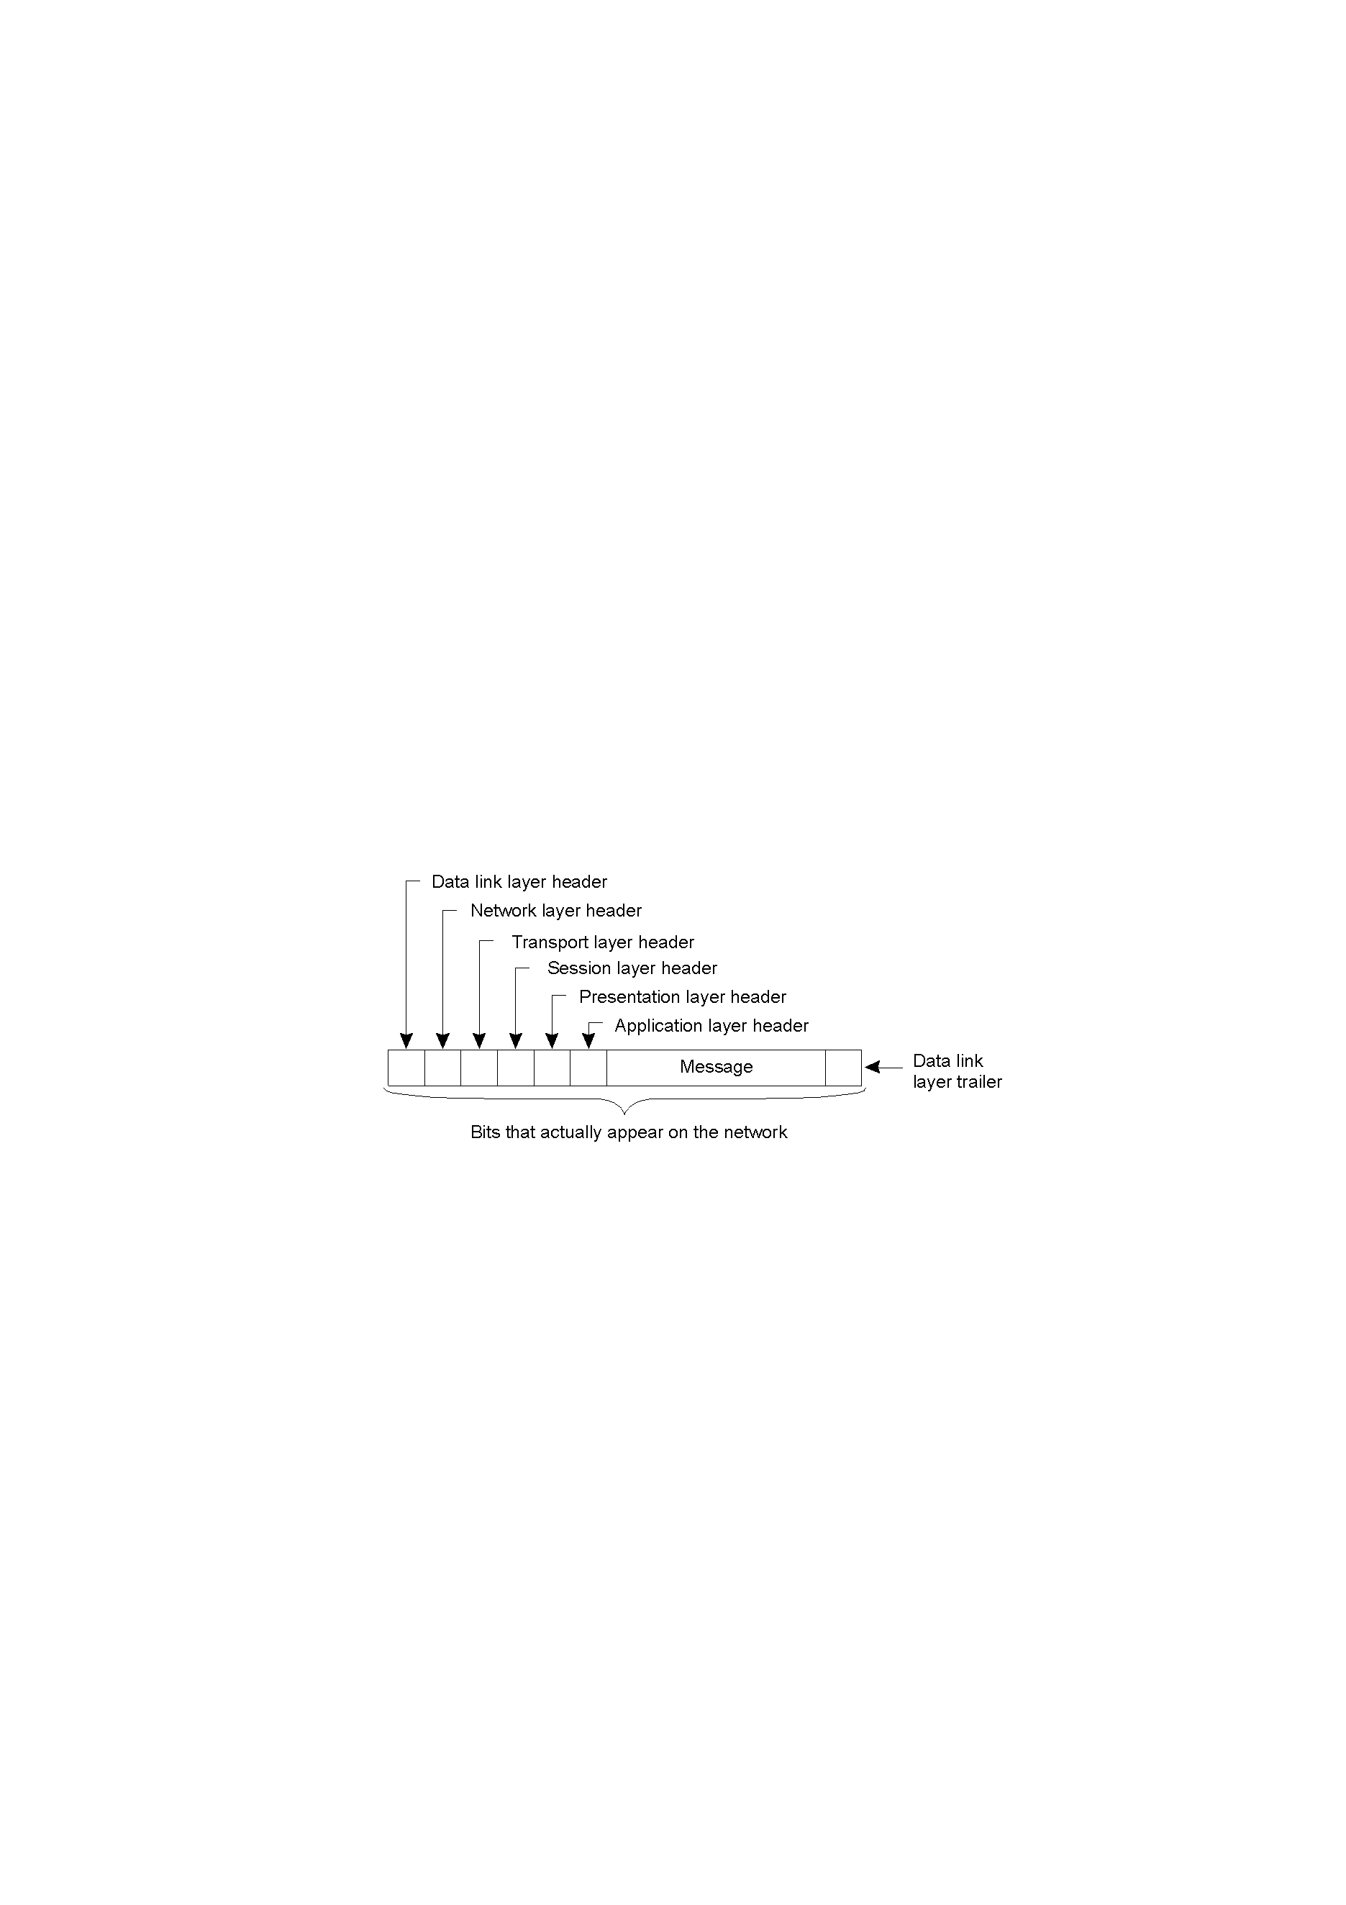
3.1 Open Systems Interconnection Model (13)
Example 3:
A typical message as it appears on the network
Frame transmission
Data packet routing
Assign communication port
Data reliability & integrity check
A unique data presentation
file
checksum
Distributed Systems
CSI3344

Slide 16
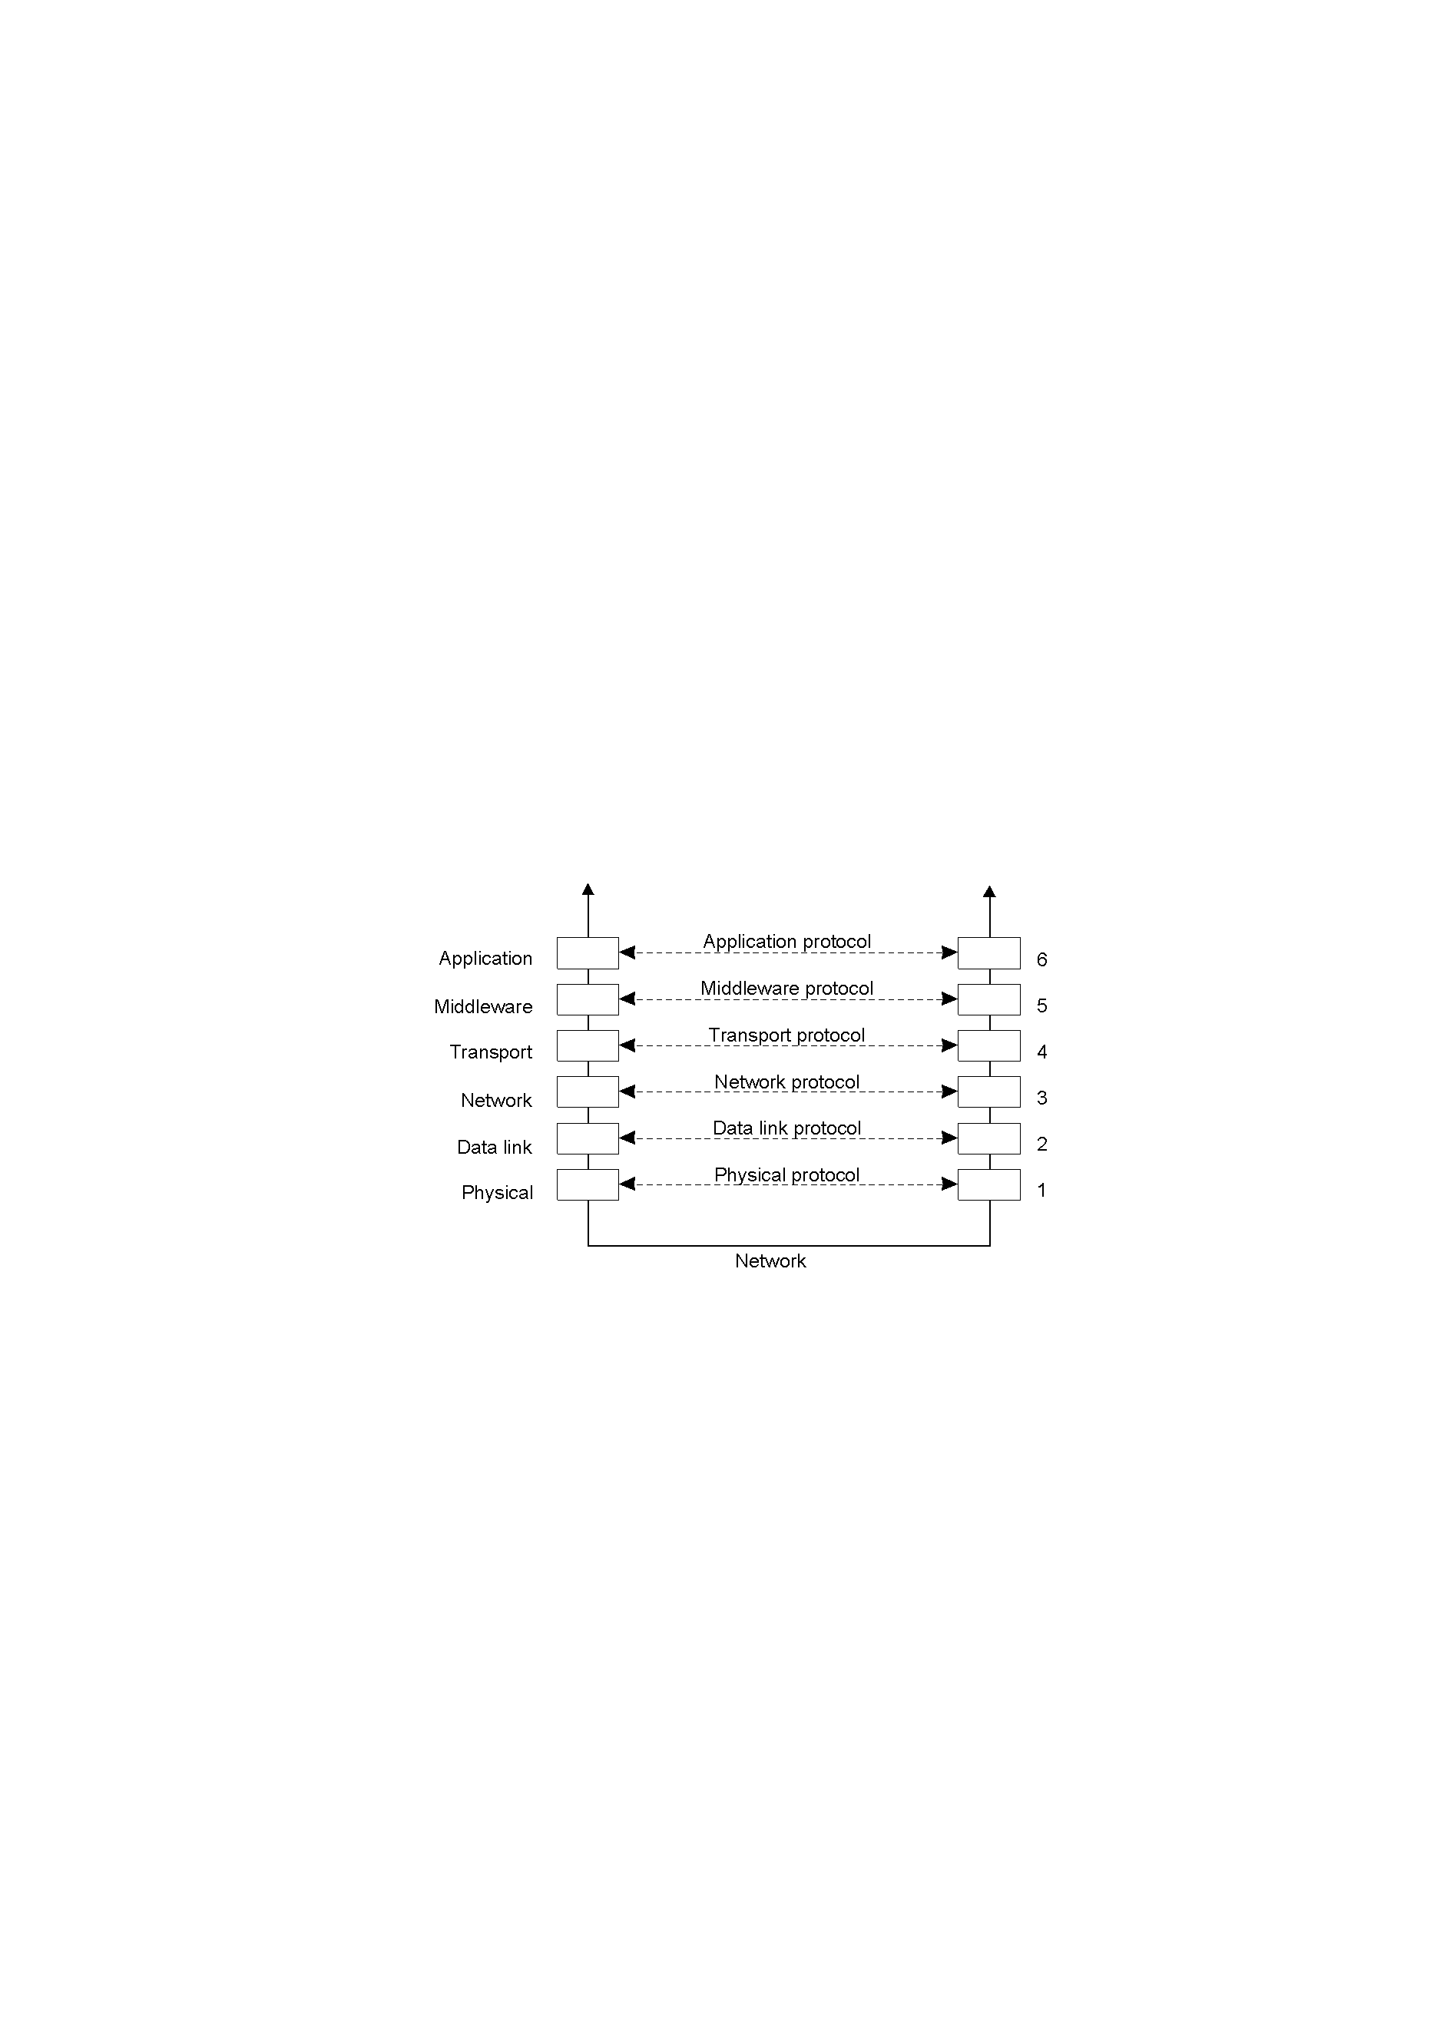
3.1 Open Systems Interconnection Model (14)
An adapted reference model for networked communication
2-5
Distributed Systems
CSI3344

Slide 17
3.1 Open Systems Interconnection Model (13)
Why do we need a middleware layer?
  The OSI application layer should only contain a collection of standard network applications such as those for email, and file transfer. Now it contains all applications (should be in), application-specific protocols not fit into any underlying layers (should be out).
  There are also many general-purpose protocols that are useful to many applications, but cannot be qualified as transport protocols.
  All these protocols fall into the category of middleware protocols, which form the middleware layer.
Distributed Systems
CSI3344

Slide 18
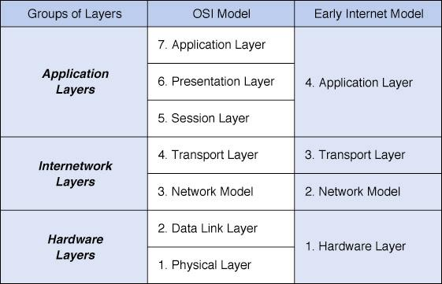
3.2 Internet Communication Model (1)
Internet communication model has 4 layers.
Distributed Systems
CSI3344

Slide 19
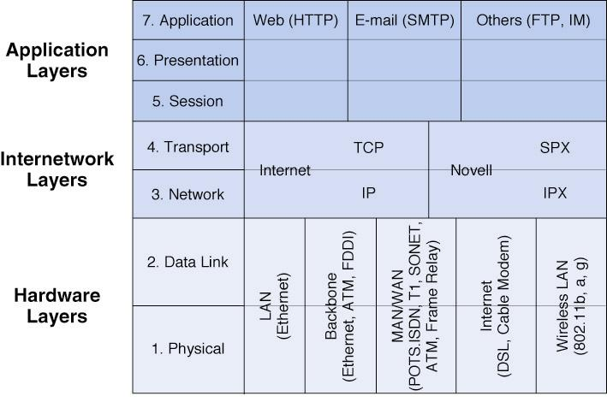
3.2 Internet Communication Model (2)
How the layers fit together in practice
Distributed Systems
CSI3344
Notes:
SMTP=Simple Mail Transfer Protocol; SPX =Sequenced Packet Exchange; IPX = Internetwork Packet Exchange
ATM =Asynchronous transfer mode; FDDI = Fiber-distributed data interface
DSL = Digital Subscriber Line;
TCP = Transmission Control Protocol; IP = Internet Protocol
POTS = Plain Old Telephone Service; ISDN = Integrated Services Digital Network
SONET = Synchronous Optical Network

Slide 20
3.2 Internet Communication Model (3)
How a message transmitted by layers?
  Generally, outgoing messages travel down all network layers.
  Before sending a message to the next layer, each layer places it in an envelope of overhead information related to that layer (encapsulation).
  At the receiving end, messages travels up through the network layers, each layer removing the envelopes added when the message was sent.
Distributed Systems
CSI3344

Slide 21
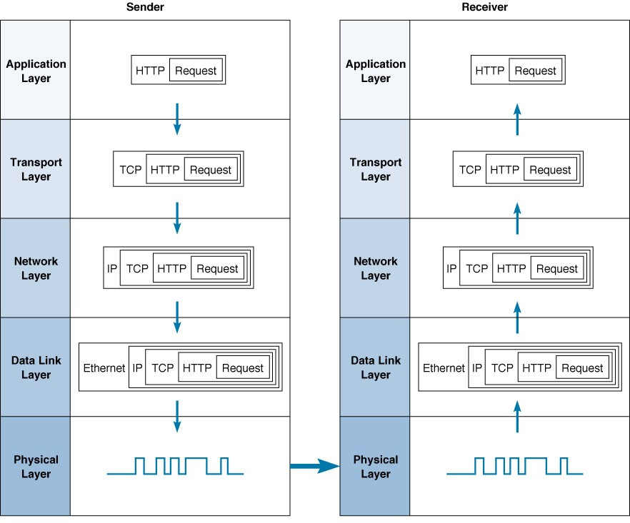
3.2 Internet Communication Model (4)
Example: Web page request
CSI3344 Distributed Systems
22

Slide 22
3.2 Internet Communication Model (5)
What happens when clicking a hyperlink
Clicking on a hyperlink starts an HTTP request-response cycle. That is, the user’s Web browser sends an HTTP request.
The HTTP request is then handed to the transport layer’s TCP protocol and placed in a TCP segment.
The TCP segment is placed in an IP (network layer) packet.
The IP packet is next placed in a Data Link layer (usually Ethernet) frame and sent out over the physical layer (network medium) as a bit stream (series of 1s and 0s).
On the Web server, this process occurs in reverse, each layer removing the overhead information added by each layer until the HTTP request is finally produced for the server to read.
The server then sends an HTTP response back to the client which is sent back to the user’s Web browser.
Distributed Systems
CSI3344

Slide 23
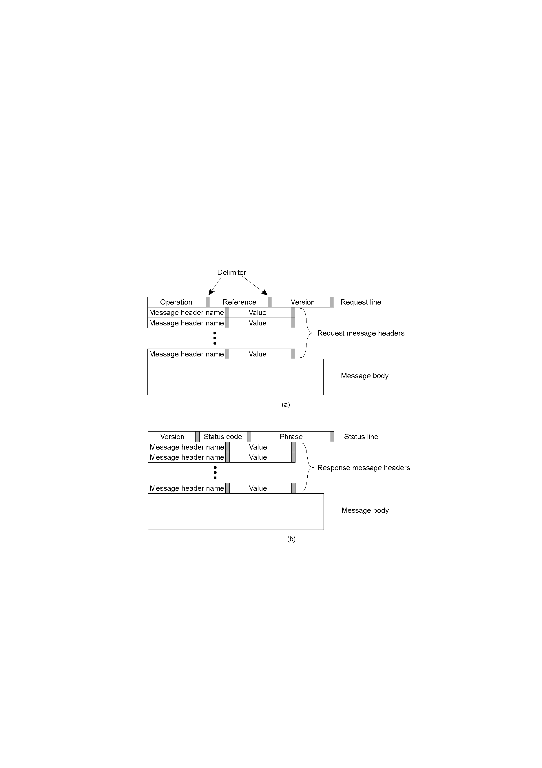
3.2 Internet Communication Model (6)
HTTP Communications (1)
HTTP Messages
Distributed Systems
CSI3344

Slide 24
3.2 Internet Communication Model (7)
HTTP Communications (2)
HTTP Messages: example
Command URL HTTP version
GET http://www.kelley.indiana.edu/ardennis/home.htm HTTP/1.1
Date: Mon 06 Mar 2011 17:35:46 GMT
User-Agent: Mozilla/6.0
Referer: http://www.indiana.edu/~aisdept/faculty.htm
]- Request Line
]- Date
]- Web browser (this is Netscape)
Request Header
URL that contained the link to the requested URL
Distributed Systems
CSI3344

Slide 25
3.2 Internet Communication Model (8)
HTTP Communications (3)
HTTP Response Message
Distributed Systems
CSI3344

Slide 26
3.2 Internet Communication Model (9)
HTTP Communications (6)
HTTP Response Message: example
HTTP ver. Status code Reason
HTTP/1.1 200 OK ]- Response Status
Date: Mon 06 Mar 2011 17:35:46 GMT ]- Date
Server: NCSA/1.3 ]- Web server
Location: http://
www.kelley.indiana.edu/adennis/home.htm ]- URL
Content-type: text/html ]- Type of file
<html>
<head>
<title>Allen R. Dennis</title>
</head>
<body>
<H2> Allen R. Dennis </H2>
<P>Welcome to the home page of Allen R. Dennis</P>
</body>
</html>
Response Header
Response body
Distributed Systems
CSI3344

Slide 27
3.3 Data Communication Standards (1)
Why Standards?
Standards provide a fixed way for hardware and/or software systems to communicate.
  For example, USB enables two pieces of equipment to interface even though they are manufactured by different companies.
By allowing hardware and software from different companies to interconnect, standards help achieving heterogeneity.
Distributed Systems
CSI3344

Slide 28
3.3 Data Communication Standards (2)
Types of Standards
There are two main types of standards:
  Formal: a standard developed by an industry or government standards-making body
  De facto: standards that emerge in the marketplace and are widely used, but lack official backing by a standards-making body
Distributed Systems
CSI3344
Notes:
De fact - Actually exercising power though not legally or officially established.

Slide 29
3.3 Data Communication Standards (3)
Some Major Standards Making Bodies
  ISO: International Organization for Standardization (www.iso.ch)
  ITU-T: International Telecommunications Union –Telecom Group (www.itu.int)
  ANSI: American National Standards Institute (www.ansi.org)
  IEEE: Institute of Electrical and Electronic Engineers (see standards.ieee.org)
  IETF: Internet Engineering Task Force (www.ietf.org)
Distributed Systems
CSI3344

Slide 30
3.3 Data Communication Standards (4)
Some common data communications standards
Layer
Common Standards
5. Application layer
HTTP, HTML (Web)
MPEG, H.323 (audio/video)
IMAP, POP (e-mail)
4. Transport layer
TCP (Internet)
SPX (Novell LANs)
3. Network layer
IP (Internet)
IPX (Novell LANs)
2. Data link layer
Ethernet (LAN)
PPP (dial-up via modem)
1. Physical layer
RS-232c cable (LAN)
Category 5 twisted pair (LAN)
V.92 (56 kbps modem)

Slide 31
Major Points
The layered (ISO) OSI Protocols
Specific aspect of each of the seven layers
Internet communication model
Relationships between OSI and Internet models
Message transmission through layers
Why standards?

Slide 32
Reading Guide
DSPP
  Chapter 4: Section 4.1
DSCD
  Chapter 3: Sections 3.3.4, 3.3.5
Additional reading
Chapter 1: Sections 1.3, 1.4
Networking in the Internet Age by A Dennis, Wiley, 2002
The OSI Model: Understanding the Seven Layers of Computer Networks,
http://ru6.cti.gr/bouras-old/WP_Simoneau_OSIModel.pdf

